Slide 1
Outsiders PowerPoint:
Ponyboy Character Analysis.

Slide 2
Portrait of Ponyboy

Slide 3
Important Ponyboy Information!

Slide 4
Physical Traits
Ponyboy’s physical traits: He has hair that is squared off in the back, is long at the front and sides, and is light brown almost a complete red. His eyes are a greenish-gray color. Has a scar on the side of his head from getting cut by a Soc.

Slide 5
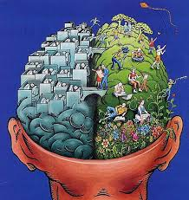
Character Traits
Ponyboy’s character traits:

